Slide 1
Truvada for PrEP:
Science and Implementation
Patricia Martin, PharmD
Director, HIV Medical Science
Gilead Sciences

Slide 2
Disclaimer
‡
These non-promotional slides are intended to be used as educational material only in response to an unsolicited question or request.
The double-dagger (‡) symbol indicates that these slides may contain information that is not within FDA approved product labeling and has not otherwise been approved by the FDA.
Notes:
‹#›

Slide 3
CDC: Numbers of Persons at Risk for HIV Remain High, but Percentages Vary by Population
PrEP: Identification
Estimated percentages and numbers of adults with indications for PrEP, by transmission risk group, United States, 2015
Transmission risk group | % with PrEP indication* | Estimated number | (95% Cl)
Men who have sex with men, aged 18-59 yrs† | 24.7 | 492,000 | (212,000-772,000)
Adults who inject drugs, aged >18yrs§ | 18.5 | 115,000 | (45,000-185,000)
Heterosexually active adults, aged 18-59 yrs¶ | 0.4 | 624,000 | (404,000-846,000)
Men** | 0.2 | 157,000 | (62,000-252,000)
Women | 0.6 | 468,000 | (274,000-662,000)
Total |  | 1,232,000 | (661,000-1 ,803,000)
Abbreviation: CI = confidence interval.
*Percentage of all estimated persons in each transmission risk group and demographic subset with PrEP indications.
†Based on 2007–2012 National Health and Nutrition Examination Survey (NHANES) data, weighted as recommended using current population estimates. Risk factors used to define PrEP indications included two or more male sex partners and at least one of the following: any condomless sex or sexually transmitted infection diagnosis in past 12 months.
§Based on 2013 National Survey on Drug Use and Health. Risk factors used to define PrEP indications included injection of heroin, methamphetamine, stimulants, or cocaine, and injecting with a needle used by someone else before them.
¶Based on 2011–2013 National Survey of Family Growth and 2007–2012 NHANES data, weighted as recommended using current population estimates. Risk factors used to define PrEP indications included two or more opposite sex partners and at least one of the following: sex with an HIV positive partner; or any condomless sex in the last 4 weeks and sex with a male who injects drugs or bisexual male (females only) in last 12 months.
**The relative standard error for males was 30.09%.
Smith D, et al. MMWR Morb Mortal Wkly Rep 2015;64:1-6

Slide 4
African Americans Have the Highest Lifetime Risk of HIV Diagnosis
Lifetime Risk of HIV Diagnosis by Ethnicity¹
African American Men
1 in 20
African American Women
1 in 48
Hispanic Men
1 in 48
Hispanic Women
1 in 227
White Men
1 in 132
White Women
1 in 880
African Americans are the most affected ethnic group with a lifetime HIV risk of 1 in 20 for men (compared to 1 in 132 for whites) and 1 in 48 for women (compared to 1 in 880 for whites)¹
Adapted from CDC at http://www.cdc.gov/nchhstp/newsroom/2016/croi-2016.html#Graphics; 1. Kristen H, et al. CROI 2016. Boston, MA. #52.

Slide 5
Lifetime Risk of Becoming HIV+ Among MSM
Lifetime Risk of HIV Diagnosis Among MSM, Overall and by Race/Ethnicity¹
MSM
1 in 6
Heterosexual Women
1 in 241
Heterosexual Men
1 in 473
African American MSM
1 in 2
Hispanic MSM
1 in 4
White MSM
1 in 11
Adapted from CDC at http://www.cdc.gov/nchhstp/newsroom/2016/croi-2016.html#Graphics; 1. Kristen H, et al. CROI 2016. Boston, MA. #52.
Notes:
noted on the lower part of the slide, AA MSM risk is 1 in 2, and Latino MSM risk is 1 in 4

Slide 6
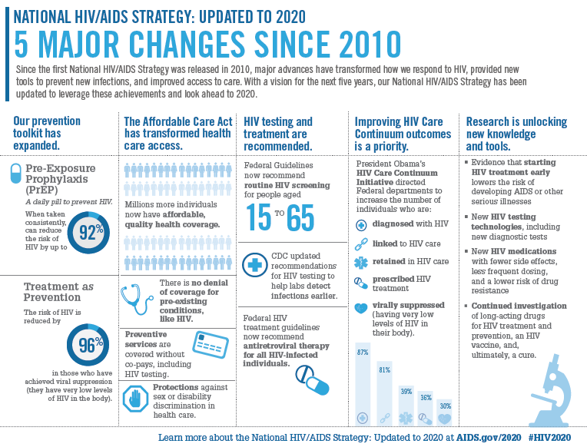

Slide 7
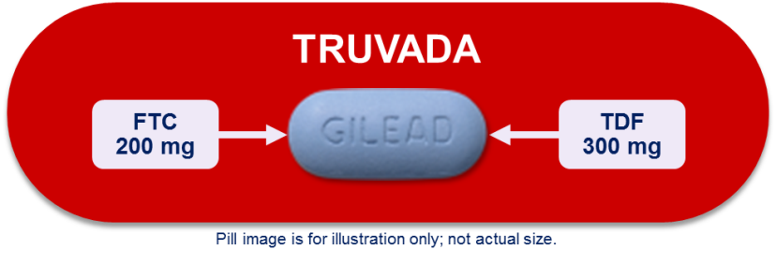
Why TRUVADA (TVD) for Pre-exposure Prophylaxis (PrEP)?
PrEP Landscape in the U.S.
Efficacy | Pre-Clinical Tenofovir disoproxil fumarate (TDF) and emtricitabine (FTC) have long intracellular half-lives (40 to >100 hours)¹ TDF and FTC effectively prevented infection in non-human primate studies²
Safety | TVD has favorable safety and tolerability profile²⁻⁵ TDF and FTC: approved in 2001 and 2003, respectively, for treatment of HIV³ and 2012 for PrEP TDF: ~9 million patient-years; FTC: ~6 million patient-years (in the commercial or clinical study settings) ³ TDF: High barrier to resistance and limited cross-resistance⁵
PK | TVD is one pill, once daily⁴ TVD can be given with or without food⁴ TFV and FTC concentrations in the genital tract exceed those in blood plasma⁵
TRUVADA is indicated in combination with safer sex practices for PrEP to reduce the risk of sexually acquired HIV-1 in adults at high risk
Garcia-Lerma J, et al. Trends Pharmacol Sci 2009; 31(2): 74-81
Chirenje Z, et al. Expert Rev. Anti Infec Therap 2010; 8(10): 1177-86.
Data on File Feb. 2015.
TRUVADA Prescribing Information. Gilead Sciences, Inc. 2013.
Cohen MS, et al. Ann Intern Med. 2007;146:591-601.

Slide 8
High-Impact HIV Prevention Incorporates Multiple Interventions
Biomedical Interventions
Behavioral Interventions
Circumcision
Patient and Partner Education
Testing and Treatment of STIs
↓Sex Partners ↓ Sharing Needles
Post-Exposure Prophylaxis (PEP)
HIV
Prevention
Strategies
Having Only One Sexual Partner
TRUVADA for PrEP
Correct and Consistent
Condom Use
TasP
Older Age at Initiation of Sexual Activity
Prevention of Mother-to-Child Transmission
Abstaining From Sexual Intercourse
Cohen M, et al. J Int AIDS Soc. 2008;11:4.
Cohen M, et al. Sexual HIV Transmission and Its Transmission. www.medscape.org/viewarticle/416415. Accessed March 10, 2016.
Notes:
TRANSITION
Per the CDC, High-impact HIV prevention focuses on both behavioral and biomedical interventions. Programs now must implement prevention programs for both HIV-positive persons and high-risk HIV-negative persons, for most CDC funding.
MAIN MESSAGE
By periodically screening for both behavioral and biologic factors that influence HIV transmission, providers can identify a wider range of risk-reduction options that are acceptable to persons with HIV, as well as, high-risk negative individuals.
Patient and partner education including HIV and STI partner notification
EVALUATION during risk assessment re: correct and consistent condom use
Circumcision – 44-71% effective in decreasing acquisition
Treatment as prevention – Undetectable VL to decrease transmission by 96%
Treatment of STIs – especially ulcerative disease, syphilis and gonorrhea can increase HIV acquisition by 3-fold
Condom efficacy is approx 80% in heterosexuals and 70% in MSM
By HIV negative people:
Before possible exposure to HIV – Pre-exposure Prophylaxis (PrEP)
After possible exposure to HIV – Post-exposure Prophylaxis (PEP)
BACKGROUND
From CDC:
“HIV prevention services are done by reducing new infections, increasing access to care, and promoting health equity. “

Slide 9






PrEP: Efficacy Rates in Clinical Trials
iPrEx
(TDF/FTC)
FEM-PrEP
(TDF/FTC)
TDF2
(TDF/FTC)
VOICE
99%
99%
(TDF)
(TDF/FTC)
42%
6%
49%
80%
CI: 15-63
CI: -52-41
CI: -22-81
CI: 25-97
Partners PrEP
(TDF)
(TDF/FTC)
-49%
-4.4%
63%
71%
66%
84%
CI: +3 to -129
CI: +27 to -149
CI: 20-83
CI: 37-87
CI: 28-84
CI: 54-94
Courtesy of Raphael J Landovitz

Slide 10
Efficacy Results from PrEP trials
PrEP Landscape in the U.S.
Clinical trial | Participants | Number | Drug | mITT ª efficacy of % reduction in acquisition of HIV infection ^{b} |  | Adherence-adjusted efficacy based on TDF detection in blood ^{c}
 |  |  |  | % | (95% CI) | % | (95% CI)
iPrEx | MSM | 2499 | TVD* | 42 | (18-60) | 92 | (40-99)
Partners PrEP | HIV discordant couples | 4747 | TDF | 67 | (44-81) | 86 | (67-94)
 |  |  | TVD* | 75 | (55-87) | 90 | (58-98)
TDF 2 | Heterosexually active men and women | 1200 | TVD* | 62 | (22-83) | 84 | NS
Bangkok Tenofovir Study | IDU | 2413 | TDF | 49 | (10-72) | 74 | (2-91)
Fem-PrEP | Heterosexually active women | 1951 | TVD* | 6e | .59-1.52 | < 40% | -----
VOICE | Heterosexually active women | 5029 | TVD* | - 4%^{e} | 0.97-2.3 | <30% | -----
PROUD | MSM | 500 | TVD* | 86 | (58-96) | ----- | -----
IPERGAY^{d} | MSM | 400 | on demand TVD* | 86 | (40-99) | ----- | -----
Modified Intent to Treat
b.Excluded only those enrolled patients later found to be infected at randomization and those with no follow-up visit or HIV test
*TVD = FTC/TDF
On-demand” regimen constitutes: FTC/TDF or 2 placebo < 24 hrs prior to sexual intercourse exposure 1 FTC/TDF or placebo dose 24 hrs after; and a final dose 48 hrs after sexual intercourse
Not statistically significant
Molin, J. et al. CROI 2015; Seattle, WA. #23LB McCormack S, et al. CROI 2015; Seattle, WA. #22LB US Public Health Services. Preexposure Prophylaxis For The Prevention of HIV Infection In The United States, 2014. http://www.cdc.gov/hiv/pdf/guidelines/PrEPguidelines2014.pdf.

Slide 11
Seroconversion Rates in Clinical Studies of FTC/TDF for PrEP
HIV-1 seroconversion rate data vary across carefully managed PrEP clinical studies of oral FTC/TDF
MSM
MSM
MSM,
TGW
Discord Hetero Couples
Hetero
Men & Women
Women
Women
France Canada
UK
S. America Africa
USA
Africa
Botswana
Africa
Africa
Seroconversion rate/
100 person-years
IPERGAY
Molina
2015
PROUD
McCormack 2016
IPREX
Grant
2010
Partner’s PrEP*
Baeten 2012
TDF2
Thigpen
2012
FemPrEP
Peterson
2007
MTN003/
VOICE*
Marazzo 2015
*FTC/TDF only. TGW, transgender women

Slide 12
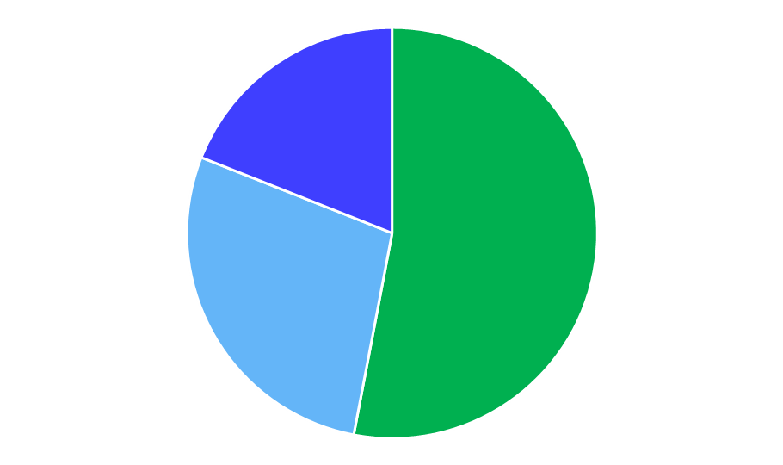
Demonstration Projects (July 2012 to May 2016)
HIV Seroconversion Rates
HIV Seroconversion Across 32 FTC/TDF PrEP Demonstration Projects
32 Demonstration Projects (NA, Africa, Europe, Australia, Asia, SA)
8,478 participants on FTC/TDF QD for PrEP (7060 PY FTC/TDF exposure)
(At risk study populations: MSM, adolescents, TGW and M, hetero M and F, and serodiscordant couple)
Seroconversion rate
( # / 100 PY)
Seroconversion (SC) rate: 0 (17 Projects)
N =2,467 participants
1,315 PY FTC/TDF exposure
>1.5
(6 Projects)
SC rate: 0.1 - 1.5 / 100 PY (9 Projects)
N =4,230 participants
3,801 PY FTC/TDF exposure
0
(17 projects)
0.1–1.5
(9 Projects)
SC rate: >1.5 / 100 PY (6 Projects)
SC rate range: 1.8–7.7 PY /100 PY
7.7 / 100 PY MSM aged 18-25 y (ATN 110*)
N =1,781 participants
1,941 PY FTC/TDF exposure
    Overall Seroconversion rate: 0.95 / 100 PY (95% CI: 0.74, 1.21) (67 HIV seroconversions)
McCallister S, et al. ASM 2016. Boston, MA. Oral
*Adolescent Trials Network

Slide 13
An “HIV Neutral” Continuum of Care
Remained
HIV-
PrEP
In Care
Evaluated
HIV Treatment Cascade
~1.1
Number of persons (millions)
Number of patients (millions)
HIV Prevention Cascade
~1.2
Diagnosed
In Care
On ARV
Suppressed
Increased HIV
testing needed

Slide 14
Who is a Candidate for PrEP?
‡
USPI: Persons at substantial HIV risk who warrant evaluation for PrEP¹:
Those who have partner(s) known to be HIV‐1 infected
Persons sexually active within a high prevalence area or social network and has ≥1 of the following risks:
No / inconsistent condom use
STI diagnosis
Exchange of sex for money, food, shelter, or drugs
Use of illicit drugs or alcohol dependence
Incarceration
The risk categories listed in the USPHS/CDC guidelines include²:
MSM: | Heterosexual Men and Women:
HIV-positive sexual partner | HIV-positive sexual partner
Recent bacterial STI | Recent bacterial STI
High number of sex partners | High number of sex partners
History of inconsistent or no condom use | History of inconsistent or no condom use
Commercial sex work | Commercial sex work
 | In high-prevalence area or network
TRUVADA Prescribing Information. Gilead Sciences, Inc. 2013.
USPHS. Preexposure prophylaxis for the prevention of HIV infection in the United States–2014. http://www.cdc.gov/hiv/pdf/guidelines/PrEPguidelines2014.pdf .

Slide 15
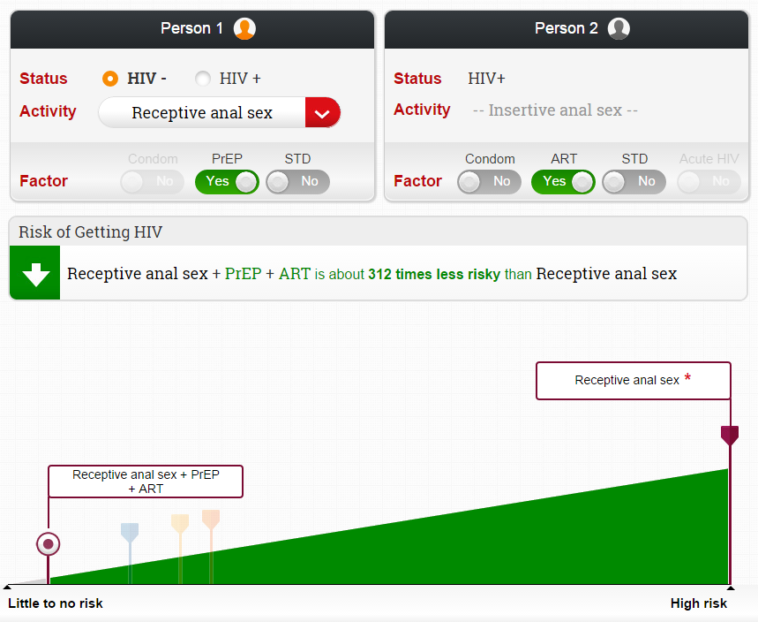
CDC HIV Risk Tool: www.cdc.gov/hivrisk
Estimating HIV Transmission Risk
‡
Available at: https://wwwn.cdc.gov/hivrisk/estimator.html# Accessed on January 11, 2016
Notes:
The website, found at www.cdc.gov/hivrisk, has customizable educational materials on HIV risk and how to reduce HIV risk.

Slide 16
Self Perception of HIV Risk is Low
PrEP: Identification
Persons undergoing HIV rapid testing in Philadelphia (N=3,533; >90% African-American) surveyed between July 2012 and Dec 2013
SELF Perception
Moderate/high risk
9.5%
TESTERS
Evaluation
Moderate/high risk
68.5%
A large proportion of patients at high risk for
HIV infection do not perceive themselves at high risk

Slide 17




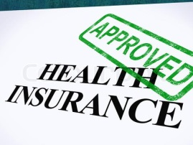
Information the Community Needs to Know
PrEP: Identification
One pill once daily
PrEP works if you take it
92%
HIV RIsk
Information
PrEP prescriber
Coverage

Slide 18
Lifetime Risk of HIV Diagnosis in the US
Midwest
West
Northeast
State | 1/n
District of Columbia | 13
Maryland | 49
Georgia | 51
Florida | 54
Louisiana | 56
New York | 69
Texas | 81
New Jersey | 84
Mississippi | 85
South Carolina | 86
North Carolina | 93
Delaware | 96
Alabama | 97
South
Highest Risk |  |  | Lowest Risk
Source: CDC. Lifetime risk of HIV diagnosis [press release]. February 23, 2016.

Slide 19
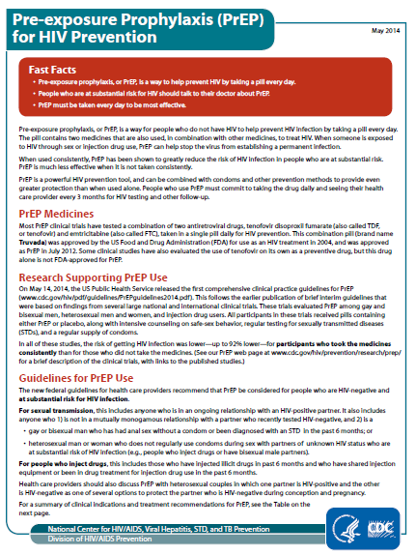
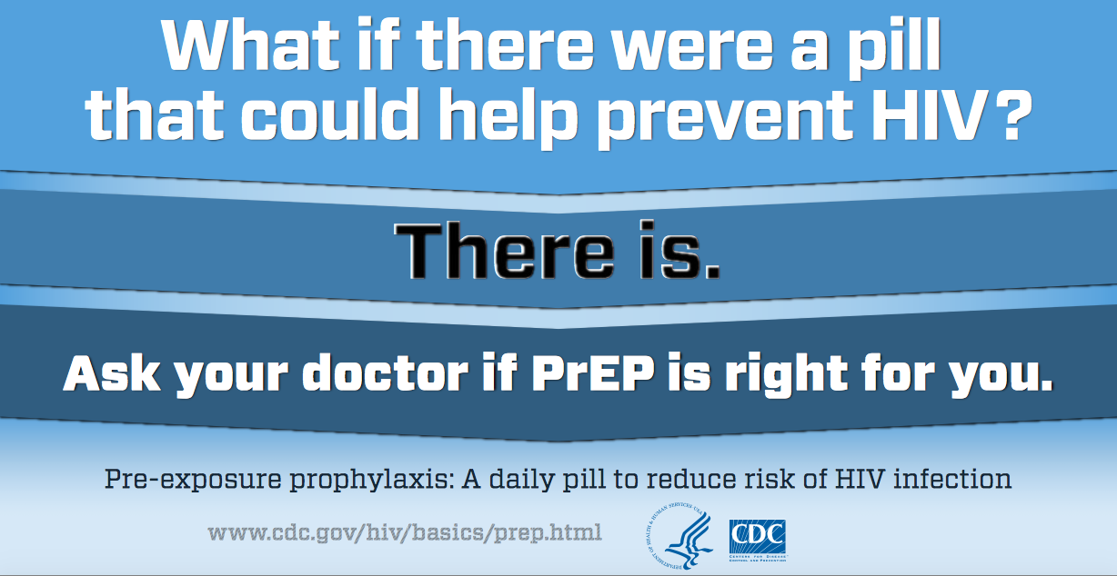
CDC Fact Sheets and Other Information
PrEP: Identification
http://www.cdc.gov/hiv/risk/prep/index.html

Slide 20
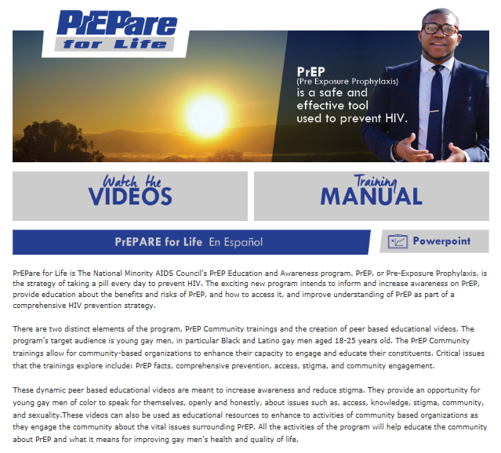
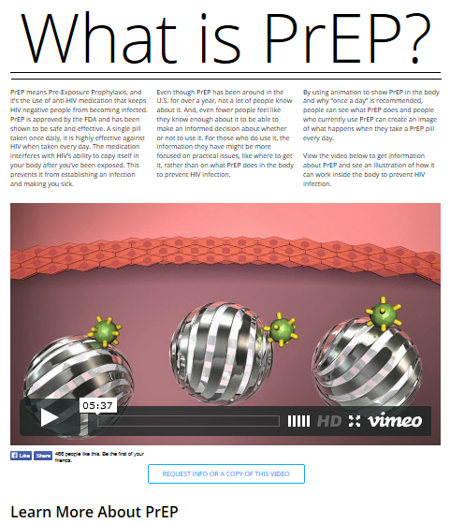

Additional Community Resources
PrEP: Identification
WhatisPrEP.org
PrEPFacts.org
ProjectInform.org
NMAC.org
NYC.gov/html/doh/html/living/prep-pep.shtml

Slide 21
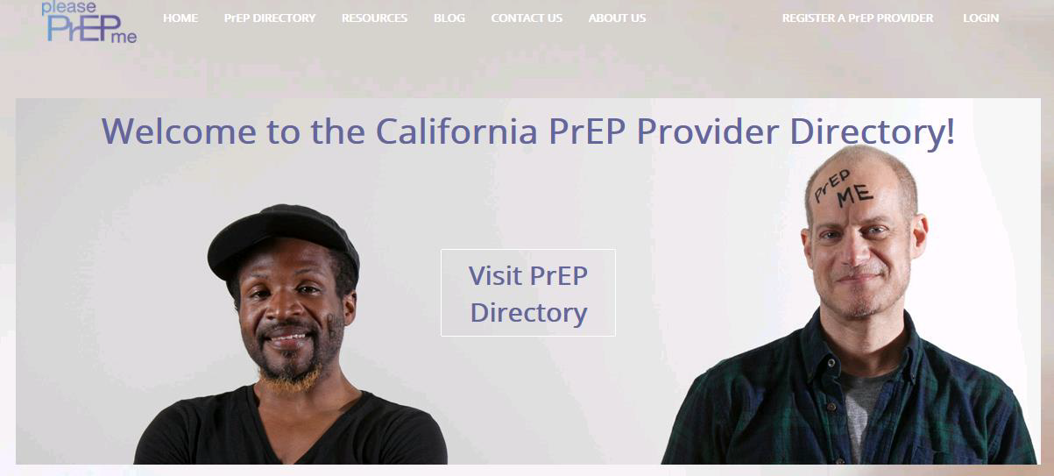
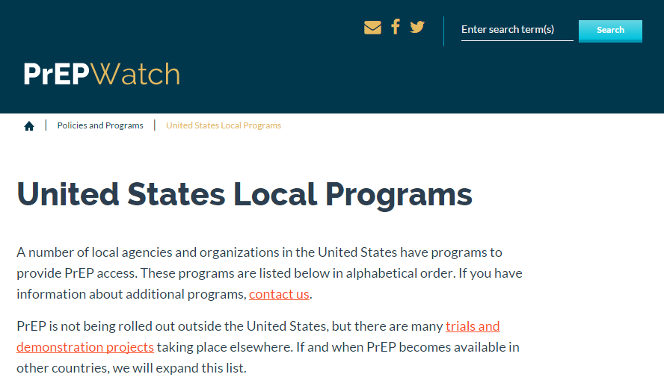
Online PrEP Provider Directories Now Exist
PrEP: Linkage to Care
Available at: http://www.pleaseprepme.org and http://www.prepwatch.org. Accessed October 27, 2015.

Slide 22
Covering the Cost of PrEP Care
PrEP: Linkage to Care
Insured
Uninsured
Potentially eligible for Medicaid or ACA plans
Ineligible for Medicaid & ACA plans
OR
Insurance denies claim
Apply
Medication
Lab Tests
Clinic Visits
  Bill insurance
  Apply for copay assistance
  Bill insurance
  Bill insurance
Household Income
<500% FPL
Household income
>500% FPL
Medication
Lab Tests
Clinic Visits
Medication
Lab Tests
Clinic Visits
  Gilead Medication Assistance Plan
  Care at CHC with sliding fee scale
  Care at CHC with sliding fee scale
  Out of pocket
  HIV testing at public clinic
  Out of pocket
  Out of pocket
ACA – Affordable Care Act
FPL – Federal Poverty Level
CHC – Community Health Center
Smith D. USCA 2015; Washington, DC.

Slide 23
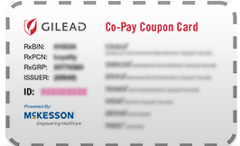
GILEAD ADVANCING ACCESS CO-PAY COUPON CARD FOR TRUVADA FOR PrEP
Covers up to $3,600 in co-pays and deductibles per year with no monthly limit
Co-pay card is not available for persons with government insurance
To enroll patients into the Gilead Advancing Access Co-pay Coupon program, please visit:
  www.gileadcopay.com or www.gileadadvancingaccess.com
  Enrollment can also be completed over the phone at 1-877-505-6986 or at 1-800-226-2056

Slide 24
TRUVADA FOR PrEP MEDICATION ASSISTANCE PROGRAM
Gilead will provide TRUVADA for PrEP at no cost for individuals who qualify for the Medication Assistance Program
Eligibility Criteria | US resident, uninsured or no drug coverage, HIV negative, low income (up to 500% of Federal poverty level)
Drug Fulfillment | TRUVADA for PrEP can be dispensed directly to patient via a US retail pharmacy of the patient’s choice, or the product can be shipped directly to the physician’s office or patient’s home
Enrollment Length | 6 months

Slide 25





Information That Providers Need to Know
PrEP: Linkage to Care
PrEP science
Who is at risk
for HIV locally
How to
prescribe PrEP
Resources
and education available
ICD
-10
Payment options
Sexual history taking

Slide 26
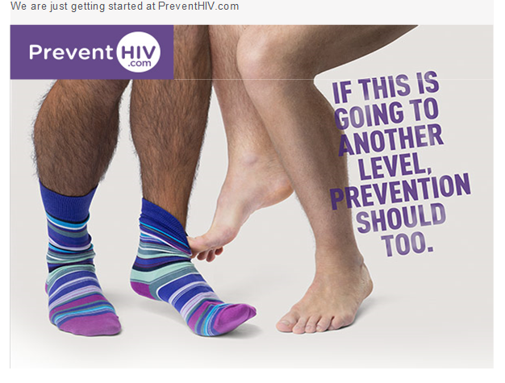
Gilead online resources
www.PreventHIV.com
www.Truvada.com
Truvada for PreP REMS Website
  www.truvadapreprems.com
  Dear Healthcare Provider Letter
  Training Guide for Healthcare Providers
  Important Safety Information for Healthcare Providers
  Safety Information Fact Sheet
  Agreement Form
  Checklist for Prescribers
  Medication Guide
  Important Safety Information for Uninfected Individuals
  Full Prescribing Information

Slide 27
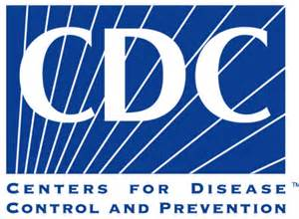




PrEP Provider Resources
PrEP: Clinical Support
 | U.S. PHS/CDC Clinical Practice Guidelines for PrEP
 | http://www.cdc.gov/hiv/risk/prep/index.html
 | HIV Prevention Capacity Building Assistance Providers
 | www.cbaproviders.org
 | HRSA-funded AIDS Education and Training Centers
 | aidsetc.org
 | PrEPLine @ UCSF Clinical Consultation Center
 | 855-448-7737
 | NACCHO’s PrEP for Local Health Departments Educational Series
 | www.naccho.org/topics/HPDP/hivsti/prep.cfm

Slide 28
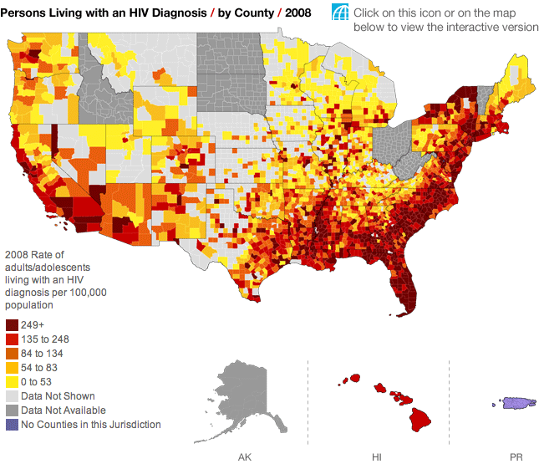
www.AIDSvu.com
Over 1 million people living with HIV in the United States

Slide 29
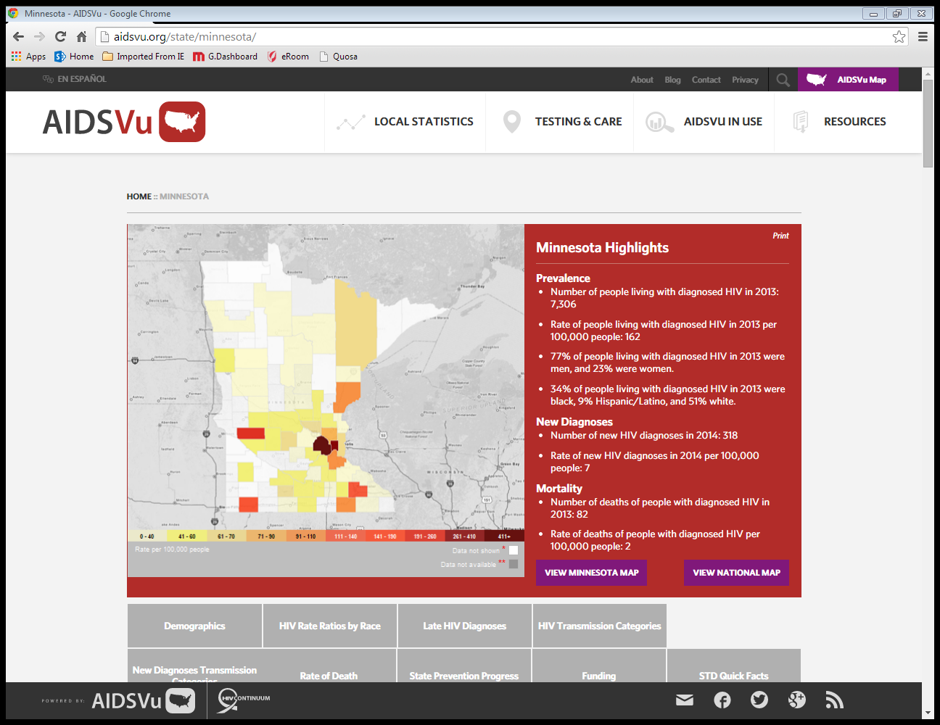
Minnesota

Slide 30
Prescribing PrEP

Slide 31
Rule Out Chronic and Acute HIV Infection
PrEP: Clinical Support
Queries for the patient:
Recent HIV exposures?
Symptoms of acute or primary HIV infection?
Perform HIV screening test
If acute HIV infection is possible:
Screen using a highly sensitive test: 4th generation or viral load test
Postpone PrEP until repeat HIV screening completed in one month
Available at: http://www.cdc.gov/hiv/prevention/research/prep. Accessed October 26, 2015.

Slide 32
DHHS / CDC Clinical Guidelines for PrEP
PrEP: Clinical Support
 | MSM | Heterosexual Men and Women | Injection Drug Users
Determine clinical eligibility | Documented negative HIV test result before prescribing PrEP No signs/symptoms of acute HIV infection Normal renal function; No contraindicated medications Documented Hepatitis B virus infection and vaccination status
Prescription | Daily, continuing, oral doses of Truvada, ≤90-day supply
Other services | Follow-up visits at least every 3 months to provide the following: HIV test, medication adherence counseling, behavioral risk reduction support, side effect assessment, STI symptom assessment At 3 months and every 6 months thereafter, assess renal function Every 6 months, test for bacterial STIs
 | Oral/rectal STI testing | Assess pregnancy intent Pregnancy test every 3 months | Access to clean needles/syringes and drug treatment services
Available at: http://www.cdc.gov/hiv/prevention/research/prep. Accessed October 26, 2015.

Slide 33
SAMPLE ICD-10 codes
PrEP: Linkage to Care
Because there are no specific ICD-10 codes for PrEP, many organizations could use resources on coding and billing related to PrEP.
Example ICD-10 code | Health condition or problem
Z11.3 | Screening for STIs
Z11.59 | Screening for viral infections, including HIV, hepatitis, herpes, others
Z20.2 | Contact with and suspected exposure to infection by sexual mode of transmission
Z20.6 | Contact with and suspected exposure to HIV
Z72.5 | High risk sexual behavior
Z72.51 | High risk heterosexual behavior
Z72.52 | High risk homosexual behavior
Z72.53 | High risk bisexual behavior
Adapted from USPHS/CDC PrEP Guideline Provider Supplement: http://www.cdc.gov/hiv/risk/prep/index.html

Slide 34
Other Relevant Laboratory Tests
PrEP: Clinical Support
Lab Test | Considerations
Renal function | PrEP should not be prescribed to persons with a creatinine clearance of < 60 ml/m
Hepatitis A and B | As PrEP may have partial efficacy against hepatitis, it is important to document infection Vaccination for hepatitis A and B is recommended for MSM
STIs | Gonorrhea, chlamydia, syphilis Screen in all appropriate anatomic sites: urethral, rectal, pharyngeal
Pregnancy | Test as appropriate
Available at: http://www.cdc.gov/hiv/prevention/research/prep. Accessed October 26, 2015.

Slide 35
Follow-up Monitoring and Discontinuation
PrEP: Clinical Support
Timepoint | Action Item
Every 3 months | Repeat HIV testing and assess for signs/symptoms of acute infection to document that patients are still HIV-negative. Repeat pregnancy testing for women who may become pregnant. Provide a prescription or refill authorization of daily TDF/FTC for no more than 90 days (until the next HIV test). Assess side effects, adherence, and HIV risk behaviors. Provide support for medication adherence and risk-reduction behaviors. Respond to new questions and provide any new information about PrEP use.
Every 6 months | Monitor creatinine clearance. Conduct STI testing recommended for sexually active adolescents and adults (i.e. syphilis, gonorrhea, chlamydia).
PrEP Discontinuation | Document HIV status Understand reason for discontinuing PrEP Counsel based on recent adherence and risk behaviors
Available at: http://www.cdc.gov/hiv/prevention/research/prep. Accessed October 26, 2015.

Slide 36
Time to Achieve Steady State Levels of TFV-DP
PrEP: Clinical Support
The time from initiation of daily oral doses of TRUVADA to maximal protection against HIV infection is unknown
Daily Oral PrEP: Time to Maximum Intracellular Concentrations of TFV-DP in Different Tissues
Rectal tissue | ~7 days
Blood | ~20 days
Cervicovaginal tissues | ~20 days
Penile tissues | No data available
TFV-DP, tenofovir diphosphate
US Public Health Services. Preexposure Prophylaxis For The Prevention Of HIV Infection In The United States, 2014. http://www.cdc.gov/hiv/pdf/guidelines/PrEPguidelines2014.pdf. Accessed June 13, 2014.

Slide 37

Special Populations: Pregnant Women
PrEP: Clinical Support
Pregnant Women
There are no adequate and well-controlled studies of TRUVADA for PrEP in pregnant women Use TRUVADA for PrEP during pregnancy only if clearly needed In uninfected women who become pregnant while taking TRUVADA for PrEP, careful consideration about continuing TRUVADA should be given, taking into account the potential increased risk of HIV-1 infection during pregnancy To monitor fetal outcomes of pregnant women exposed to antiretroviral regimens, an Antiretroviral Pregnancy Registry (APR) has been established. Health care providers are encouraged to register patients by calling 800-258-4263
Available at: http://www.cdc.gov/hiv/prevention/research/prep. Accessed October 26, 2015.

Slide 38

Special Populations: Adolescents
PrEP: Clinical Support
Adolescents
TRUVADA for PrEP is not indicated for persons <18 years of age. The data on efficacy and safety in adolescents are insufficient. The risks and benefits of PrEP for adolescents should be weighed carefully in the context of local laws and regulations about autonomy in health care decision-making by minors
Available at: http://www.cdc.gov/hiv/prevention/research/prep. Accessed October 26, 2015.

Slide 39
Questions

