Slide 1
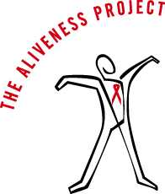
HIV/AIDS: The Basics
Hanna Dorn
The Aliveness Project

Slide 2
Do you know anyone who is (or was)
living with HIV?

Slide 3
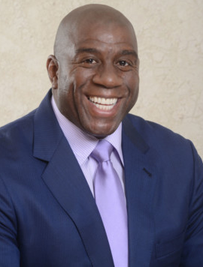
True or False?
Anyone can get HIV.
HIV and AIDS are the same thing.
About 1 out of every 300 Americans are living with HIV.
People with HIV/AIDS have just a few years to live.
Magic Johnson is “undetectable,” so he must be cured.

Slide 4
Human Immunodeficiency Virus

Slide 5
Acquired
Immune
Deficiency
Syndrome

Slide 6
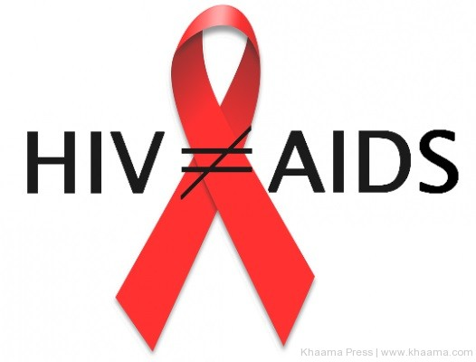
HIV
AIDS
Virus that causes AIDS
Late stage of HIV disease
T-cell count below 200
Opportunistic infection(s)
  Wasting
  Specific cancers
  Infections caused by fungi, parasites, viruses, and bacteria
Notes:
Healthy immune system has 800-1200 T-cells

Slide 7
Timeline
Pre-1980: chimp-human crossover in the Congo
1981: opportunistic infections in gay men in NY, CA
1982-83: CDC uses “AIDS,” transmission identified, thousands of deaths worldwide
1985-86: first test, Rock Hudson, Ryan White, Reagan first mentions AIDS, 40,000 cases in 85 countries, “HIV” coined
1987-89: AZT, Liberace, Robert Mapplethorpe, Keith Haring

Slide 8
1991-92: Magic Johnson, Freddie Mercury, Arthur Ashe, red ribbon
1993-94: AIDS #1 cause of death in US aged 25-44, US visitor ban, Pedro Zamora
1995-96: 23 million cases globally, HAART → US diagnoses decline, Greg Louganis, Eazy-E
2001-02: Global Fund created, generic drugs, rapid test, HIV leading cause of death in Sub-Saharan Africa
2009-10: Obama calls for Nat’l HIV/AIDS Strategy, lifts travel/immigration ban, PrEP, one pill a day
2015: 37 million cases globally, Charlie Sheen

Slide 9

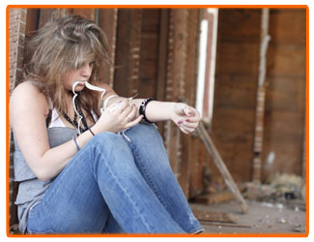
HIV Transmission

Slide 10
What body fluids transmit HIV?
  Blood
  Semen
  Vaginal Fluid
  Breast Milk (trace amounts)
What body fluids do NOT transmit HIV?
  Spit, Mucus
  Sweat, Tears
  Urine, Feces
  Vomit
Notes:
MAP: http://www.mnaidsproject.org/education/educate-yourself/hiv-transmission.php, only 11 vertical transmissions in MN since 1996

Slide 11
Modes of Transmission
Sex without a condom (with someone who is HIV+)
  Anal and vaginal sex
Sharing syringes (with someone who is HIV+)
  Only 2% of new HIV diagnoses in MN relate to IV drug use
Mother-to-child
  No babies born with HIV in Minnesota over the past several years

Slide 12
Is HIV Easy to Catch?
-Dies outside the body within 1-2 minutes
-Can live in a syringe for 5-7 days
For transmission to occur:
HIV must be present
There needs to be enough virus
HIV must get into the bloodstream

Slide 13
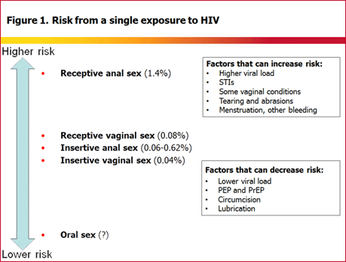
Notes:
Condom misuse, compromised immune system due to drug/alcohol use may increase risk; “Vaginal Conditions” (physical trauma/assault, dry sex, rough sex) Graph courtesy of Canadian Health Department

Slide 14
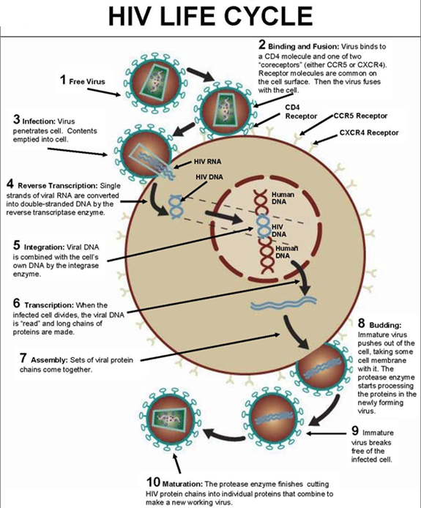
Notes:
aidsinfonet.org

Slide 15
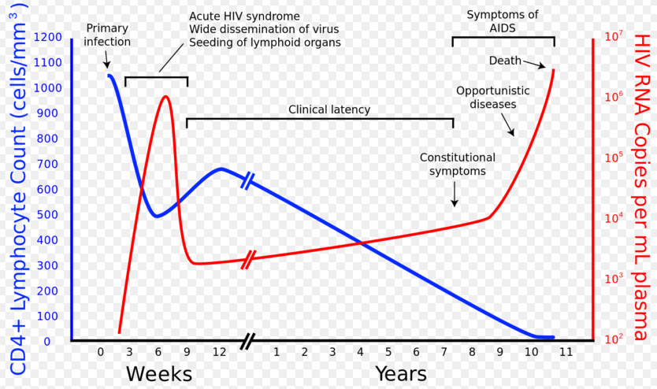
Notes:
Majority of transmission occur during first 2-6 weeks of infection (risk of infecting others is 26x higher). Graph courtesy of University of Chicago

Slide 16
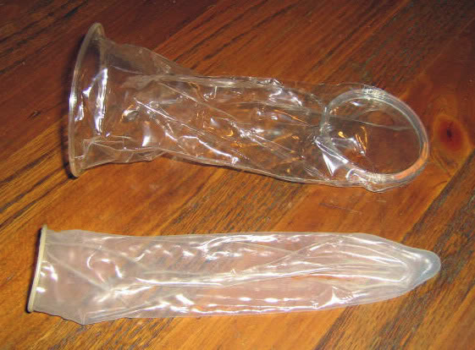
Ways to Lower Your Risk

Slide 17
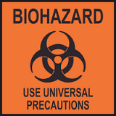
Universal Precautions
Treat all human blood and infectious body fluids as if they could carry HIV and other pathogens.

Slide 18
Post Exposure Prophylaxis (PEP)
The “morning after” equivalent - within 72 hours of exposure
One month of HIV meds (must be 95% adherent)
Covered by public health insurance
Over 90% effective in preventing HIV transmission

Slide 19
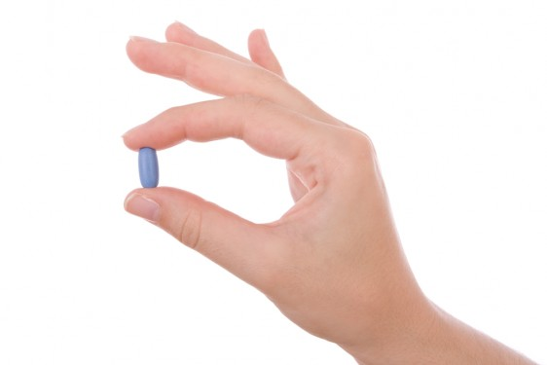
Pre Exposure Prophylaxis (PrEP)
Like birth control, but for HIV
For high risk HIV- people: MSM, serodiscordant couples, sex workers
1x/day Truvada (must be 95% adherent)
Covered by insurance
Up to 99-100% effective in preventing HIV
Notes:
PrEP side effects minimal – light headaches, monitor kidney function

Slide 20
Condoms
Must be used consistently and correctly
  Storage
  Expiration date
  Correct lubrication
  Putting it on correctly (reservoir tip!!)
  Latex or non-latex alternative
Receptive condoms can be used vaginally or rectally
Flavored condoms should never be used vaginally
Notes:
Lube: no oil-based like petroleum jelly, baby oil; “natural lambskin” condoms don’t prevent HIV

Slide 21
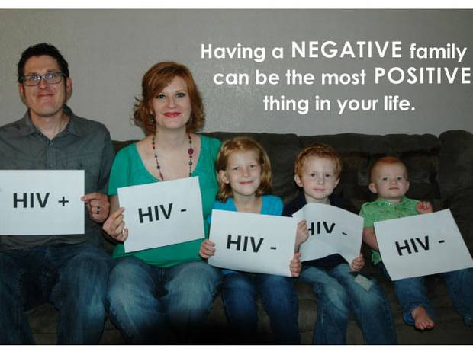
Treatment-as-Prevention
HIV+ people on medication who are “undetectable” are 96% less likely to transmit HIV (studies ongoing, transmission risk may even be ZERO)

Slide 22
Harm Reduction
IDU Outreach
  Syringe exchange (call MAP AIDSline at (612) 373-2437)
  “Friendly Pharmacies” law: 10 syringes without prescription (but at pharmacist’s discretion)
  Rule 25 assessments, risk reduction counseling, support groups, and treatment programs

Slide 23
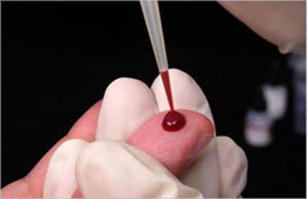
Testing

Slide 24
Why Get Tested?
Most common symptom of STIs is NOTHING (feeling fine and having no symptoms)
It’s free, confidential, and quick.
You’re protecting yourself and your partner.
It’s better to know! If you know your HIV status, you can do something about it. If you are negative, great. If you are positive, start treatment and go on with your life.
Anyone who has ever had sex or used injection drugs should get screened regularly.

Slide 25
CDC recommends that individuals aged 13-64 get tested at least once in their lifetimes. People with risk factors should get tested at least annually. MSM may benefit from getting an HIV test more often, perhaps every 3-6 months.
HIV testing should be part of routine care provided at check-ups and physicals, but up to individual practitioners….

Slide 26
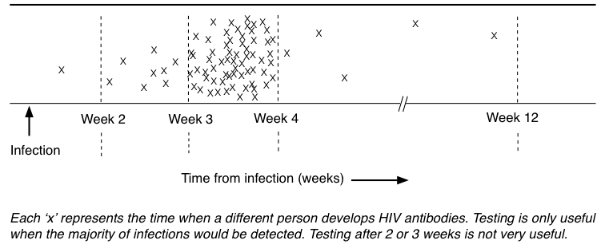
Window Period
Notes:
iBase: http://i-base.info/guides/testing/what-is-the-window-period

Slide 27
Most tests look for antibodies, which take up to 3 months to develop
Rapid tests give results on the spot in 15-20 minutes - home tests available, but better to have a counselor
Get tested at
  The Aliveness Project (free)
  3808 Nicollet Avenue, (612) 822-7946
  Minnesota AIDS Project/MAP (free)
    (moving from Mpls to SP), (612) 341-2060
  Red Door Clinic (sliding scale)
    525 Portland Avenue S, (612) 543-5555

Slide 28
Blood and Plasma Donation
All blood/plasma donations are screened for HIV. In the event of a reactive test, the blood bank contacts the health department. A disease investigator will contact the individual to assist them in receiving medical care and notifying their partners.

Slide 29
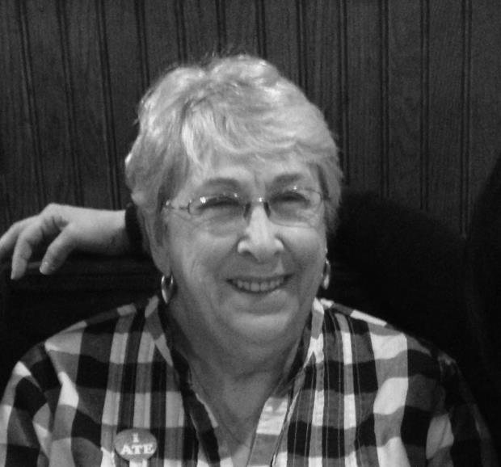
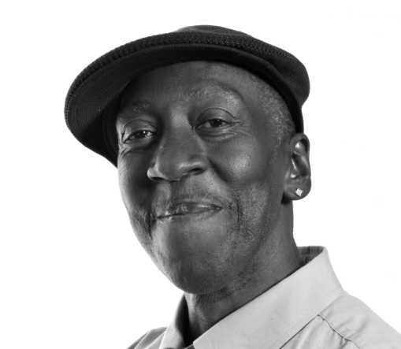
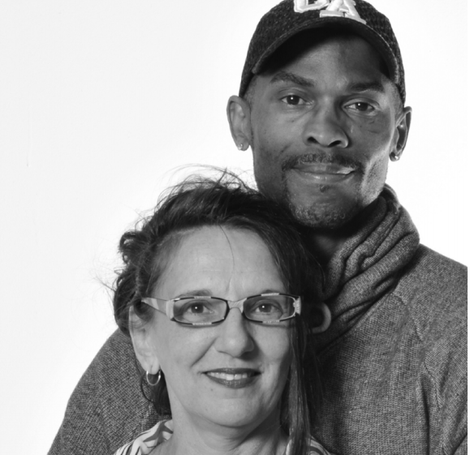
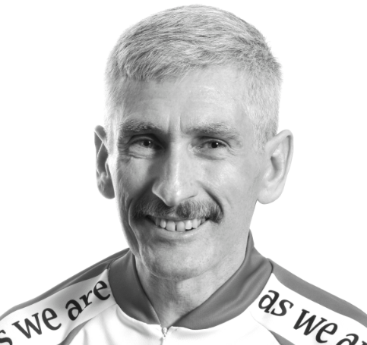
Living with HIV

Slide 30
HIV in Minnesota
Roughly 8,000 people living with HIV
307 new HIV diagnoses in 2014
Great disparities in new diagnoses persist among populations of color
Male-to-male sex remains the leading risk factor for acquiring HIV
Foreign-born people made up nearly 20% of new HIV infections in 2014
Considered a low incidence state

Slide 31
HIV in America
1.2 million Americans are living with HIV
New diagnoses remain steady at 50,000 annually
People of color are disproportionately represented. Over the course of their lifetimes, 1 in 16 black men will be diagnosed with HIV infection.
The CDC estimates 20% of urban MSM are HIV+. Transgender women are 49 more likely to have HIV than the general public. Why do you think queer people experience higher rates of HIV than the general population?

Slide 32
HIV in the World
36.9 million people around the world are living with HIV, including 2.6 million children
70% of global total in sub-Saharan Africa
22 million people with HIV do not have access to treatment
HIV is responsible for 39 million deaths since the early 1980s

Slide 33
HIV Medications
Goal of treatment: suppressed or “undetectable” viral load of less than 50 copies/ml
Adherence: cannot skip more than 1 dose/month
Early treatment means 41% fewer HIV-related illnesses and reduces transmission by 96%
What are reasons some people living with HIV don’t take medications?
Notes:
Reasons of lack of adherence: unsteady insurance, denial, substance use, privacy, mental illness, instability, side effects, distrust of medical system, disbelief in Western medicine

Slide 34
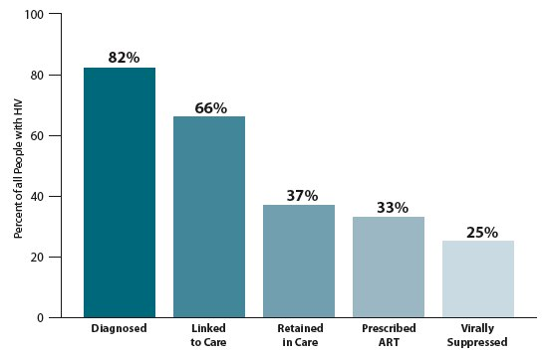
Treatment Cascade

Slide 35
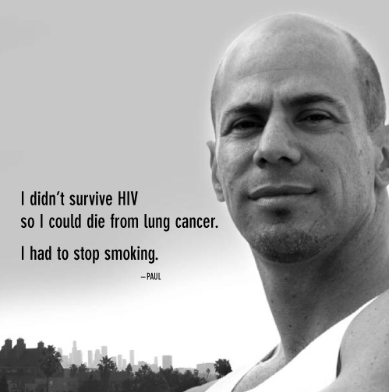
Co-occuring Issues of Concern
Heart Disease
Cancer
Hepatitis C
Mental Health Disorders
Substance Abuse
Smoking
Notes:
Hep C: 3.2 nationally, 100x more infectious than HIV, can live 6 weeks on surfaces, 9 weeks in syringe; 40% of AIDS deaths are thought to be related to substance abuse

Slide 36
Stigma
What are some of the reasons people living with HIV and AIDS experience stigma and discrimination?

Slide 37
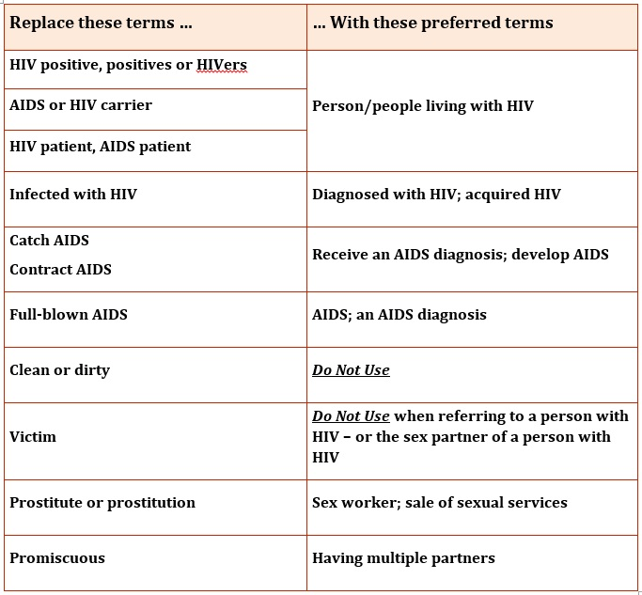

Slide 38
Laws about HIV
Americans with Disabilities Act
  protects people living with HIV from discrimination in housing and workplace
Minor Consent Law
  Minors 12 and up can consent to medical, mental, and other health services without parental consent
Knowing Transfer of a Communicable Disease
  No need to disclose if condoms or other protection is used
Notes:
But if minor is on parent’s insurance, an explanation of benefits will be sent to parents

Slide 39
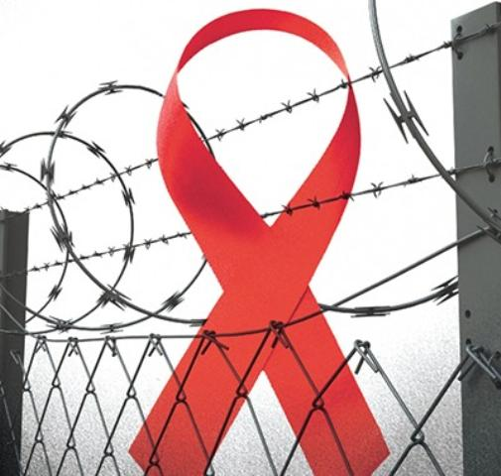
HIV in Prison
Opt-out testing
97% of people living with HIV in Minnesota prisons are undetectable
Condoms are not allowed

Slide 40
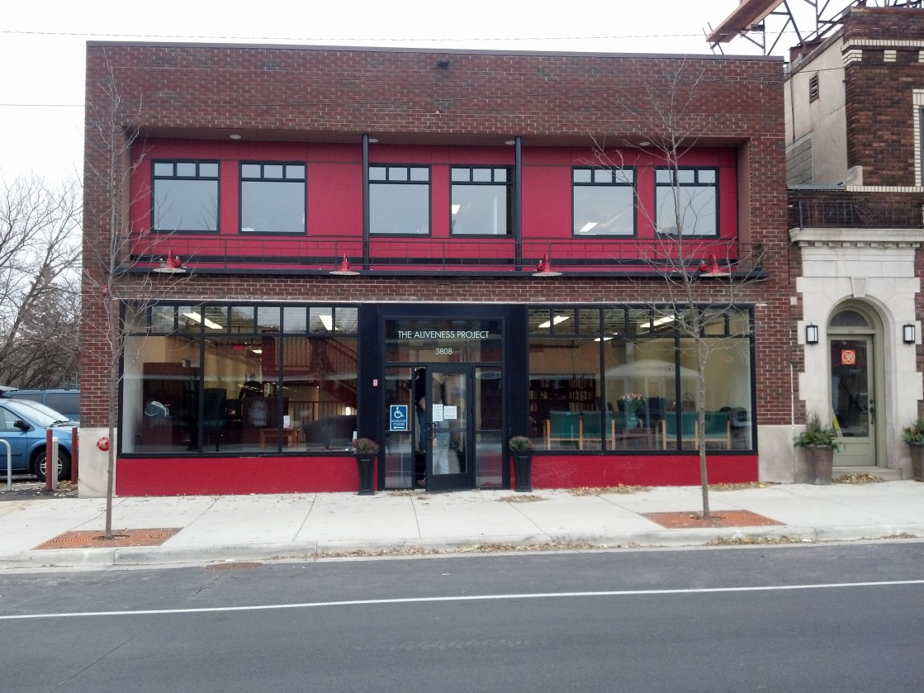
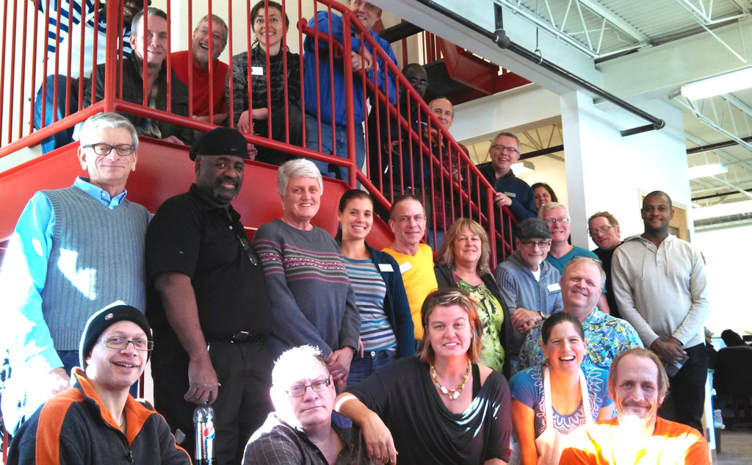
The Aliveness Project

Slide 41
The Aliveness Project
Founded in 1985 by HIV+ gay men gathering for potlucks in Minneapolis
Support center for Minnesotans living with HIV, all services FREE
For members: hot meals, food shelf, nutrition, case management and health care linkage, therapies, patient education, resource library, special programs (holiday baskets, tickets, yoga, etc.)
For public: volunteer opportunities, rapid HIV testing, MNSure Navigation

Slide 42
The Aliveness Project in 2014
Served over 32,000 hot meals
Gave out 140,000 lbs of groceries
Over 3,200 physical/mental therapy sessions
Holiday gifts for almost 700 families and individuals
Supported by government grants, private foundations, individual donors, and fundraising (Dining Out for Life, Red Ribbon Ride, Walk to End Hunger, charitable gaming). 8% admin, 5% fundraising, 87% services!

Slide 43
Roughly 2,000 members, 1800 volunteers, small staff of mostly part-time employees
Member demographics:
  50% white, 50% people of color
  50% MSM, 50% heterosexual
  75% men, 25% women
  80% aged 30-60, 10% under 30, 10% over 60
  80% metro area, 20% rural
  70% make < $12K/year, 20% make < $20K/year

Slide 44

Common Questions
Can you answer these?

Slide 45
Do I need to get tested? Where can I get tested and what is it like?
Is there a cure for HIV?
Can I get HIV from casual contact?
Can I get HIV from oral sex?
How effective are condoms?
How can I be safer if I’m using IV drugs?

Slide 46
What is PEP/PrEP?
What is safe vs. risky?
How can I tell if I’m infected?
How long does it take for HIV to cause AIDS?
What happens if I’m HIV+?
Is HIV a death sentence?

Slide 47

HIV Jeopardy!
https://jeopardylabs.com/play/hivaids-jeopardy23

Slide 48
Thank you! Please contact me with any questions.
Hanna Dorn
Front Desk/Outreach Program
HIV Testing & Risk Reduction Counselor
hanna@aliveness.org
The Aliveness Project
3808 Nicollet Avenue
Minneapolis, MN 55409
Phone (612) 822-7946
Fax (612) 822-9668
www.aliveness.org

