Slide 1
The Brooklyn Bridge Alliance for Youth
Opportunity Site Presentation
December 9, 2019

Slide 2
Statement from Brooklyn Center Community Schools
Brooklyn Center Community Schools are happy to be a part of the City’s Community Engagement initiative for the Opportunity Site. We have partnered with the Brooklyn Bridge Alliance for Youth to engage Brooklyn Center students in the process. Through their leadership, Brooklyn Center students were able to share their wishes and concerns for their schools, families and community.
The Brooklyn Center school board thanks the Alliance, Mayor Elliott and our City council members for the opportunity to give a voice to our young people as they will be our future taxpayers and leaders.
Sincerely,
Cheryl Jechorek, BCCS Board Chair

Slide 3
Background
Partnered with Judith Marquez from Citizens League and Brooklyn Center Community Schools to conduct consensus-building workshops to inform the city on what youth want to see in the 2040 Comprehensive Plan and the Opp. Site.
Youth-centric facilitation team
BYC Members
  Tiffany Nyamao
  Caron Iteghete
  Alex Garcia
  Kimberly Vasquez
  Catalina Moua
Former BYC member
  Francis Best
BBAY Staff
  Julie Richards
  Andrew Mua
City of Brooklyn Park
  Pam McBride

Slide 4
Engagement Goals
We sought to model how a youth-adult partnership approach is possible for gathering authentic youth input to:
Inform the city of Brooklyn Center 2040 Comprehensive Plan implementation; including both policies and strategies to move the goals of the plan forward,
Inform direction on the Brooklyn Center Opportunity Site development,
Share with Citizens League comprehensive plans, and approaches for youth community engagement, and to
Inform the Brooklyn Bridge Alliance environmental scanning efforts as a run up to the 2020 Youth to Youth community survey, and to our 2021 strategic plan.

Slide 5
Facilitation Method
Youth-as-Facilitative Leaders (YFL)
Consensus-building workshop that allows consensus to be built from all participating members, regardless of their positioning, through participatory methods
“What do you want to see in Brooklyn Center in 2040 that would help you reach your fullest potential, stay in Brooklyn Center and build an awesome city?”

Slide 6
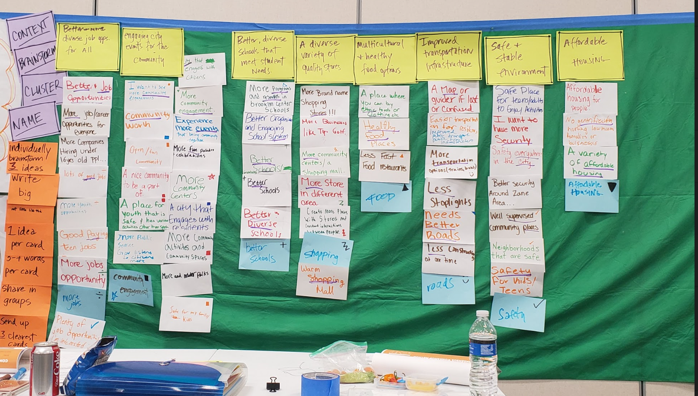

Slide 7
Community Involved
81 participants ages 14-18
78 attend school in Brooklyn Center (BCHS and ECA)
51 live in Brooklyn Center
15 racial and ethnic identities
33 youth selected more than 1 racial or ethnic identity

Slide 8
Disaggregated Data

Slide 9
Here’s what Youth Said
1. Investing more funds into schools and education
Paying teachers a higher salary
Better meal options
More education surrounding future life skills
More social awareness on people from different backgrounds – like LGBQT community
Providing more college- prep opportunities

Slide 10
Here’s what Youth Said
2. Expanded Retail and Entertainment Options
What they want
More retail options
  Mall, brand stores
More entertainment options like…
What they don’t want
Large entertainment businesses without accessible pricing options
  Eg. Top Golf
  Bowling
  Movie Theatres

Slide 11
Here’s what Youth Said
3. Affordable housing opportunities and expanded housing
What they want
Affordable housing that could accommodate families in Brooklyn Center
Housing for homeless
What they don’t want
Housing disparity as a result of these developments
  Eg. Increasing rent which burdens residents

Slide 12
Here’s what Youth Said
4. Community Spaces for Youth and Families to bond
What they want
Spaces for youth and families to bond with their larger community
  Festivals, Parades, Themes
  Public art – Graffiti / Mural Wall
What they don’t want
“Not just sports” – Community engagement for youth and families in all interests

Slide 13
Additionally…
5. Teen Specific Spaces
6. Food Diversity
11. Care for the environment
7. Sports and Recreation
12. Other
8. More job opportunities for youth and adults
9. Roads and Transportation
10. Safe and Welcoming Community

Slide 14
Conclusion
Four Major Themes
Investing more funds into schools and education
Expanded retail and entertainment options
Affordable housing opportunities and expanded housing
Community spaces for youth and families to bond
Acknowledging the tension between development and community continuity
  More work may be needed to inform or ask youth
  These suggestions do not need to be “either / or”
  Realities of where some youth may be and where they will be
As the city continues their development initiatives we request the city to keep residents informed and ask people most impacted by development, keep asking Youth

